Slide 1

Off-policy TD control – Q learning
We learned that in the SARSA method, we select action a in state s using the epsilon-greedy policy, move to the next state s’ and update the Q value using the update rule shown here.
In the preceding equation, in order to compute the Q value of next state-action pair, we need to select an action. So, we select the action using the same epsilon-greedy policy and update the Q value of the next state-action pair.
But unlike SARSA, in Q learning, we use two different policies. One is the epsilon-greedy policy and the other is a greedy policy. To select an action in the environment we use an epsilon-greedy policy, but while updating the Q value of the next state-action pair we use a greedy policy.
So, Q learning Update Rule..
As we can observe from the preceding equation, the max operator implies that in state s’, we select the action a’ that has the maximum Q value.

Slide 2
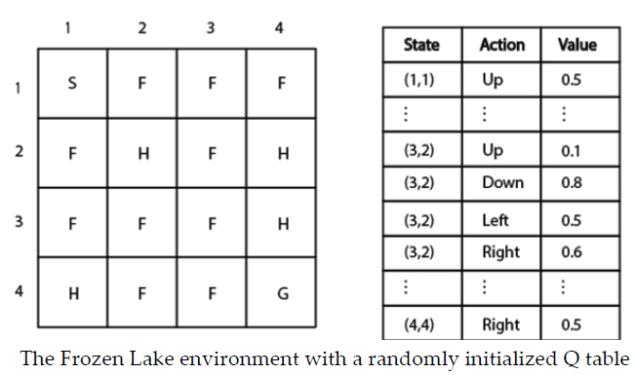
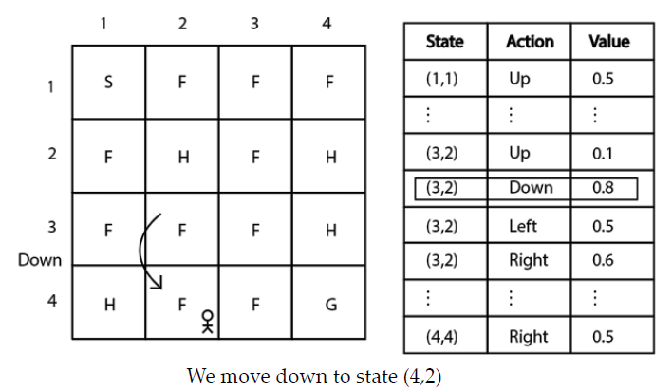
Let's use the same Frozen Lake example. We initialize our Q table with random values.
Assume we are in state (3,2). Now, we need to select some action in this state.
We select an action using the epsilon-greedy policy. So, with probability epsilon, we select a random action and with probability 1-epsilon we select the best action that has the maximum Q value.
Say we use probability 1-epsilon and select the best action. So, in state (3,2), we select the down action as it has the highest Q value compared to other actions in that state,
so, we perform the down action in state (3,2) and move to the next state (4,2) and and receive a reward r of 0

Slide 3
How can we update the Q value?
Substituting the state-action pair Q(s,a) with Q((3,2), down) and the next state s’ with (4,2) in the Q learning update rule.
Substituting the reward, r = 0, the learning rate 0.1 and the discount factor 1.
From the previous Q table, we can observe that the Q value of Q((3,2), down) is 0.8. Thus, substituting Q((3,2), down) with 0.8
As we can observe, in the preceding equation we have the max term, which represents the Q value of the next state action pair as we moved to the new state (4,2).
In order to compute the Q value for the next state, first we need to select an action. Here, we select an action using the greedy policy, that is, the action that has maximum Q value.

Slide 4
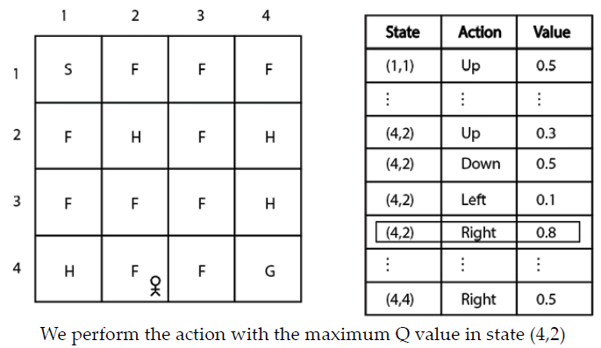


we select the right action and update the Q value of the next state-action pair as the right action has the maximum Q value in state (4,2).
Now update rule becomes,
Similarly, we update the Q value for all state-action pairs. That is, we select an action in the environment using an epsilon-greedy policy, and while updating the Q value of the next state-action pair we use the greedy policy. Thus, we update the Q value for every state-action pair.
we update the Q function by updating the Q value of the state-action pair in each step of the episode. We will extract a new policy from the updated Q function on every step of the episode and uses this new policy. After several episodes, we will have the optimal Q function.

